Slide 1
Organization of Human Body and Introduction to Physiology
Dr Shahneela Siraj
Associate Professor
DIKIOHS,DUHS.

Slide 2
Learning Objectives
By the end of the Lecture , the student should be able to :
Define Physiology
Appreciate the different levels of organization in the human body.
Understand the different body systems of a human body and their major components.
Explain extracellular fluid and the internal environment

Slide 3
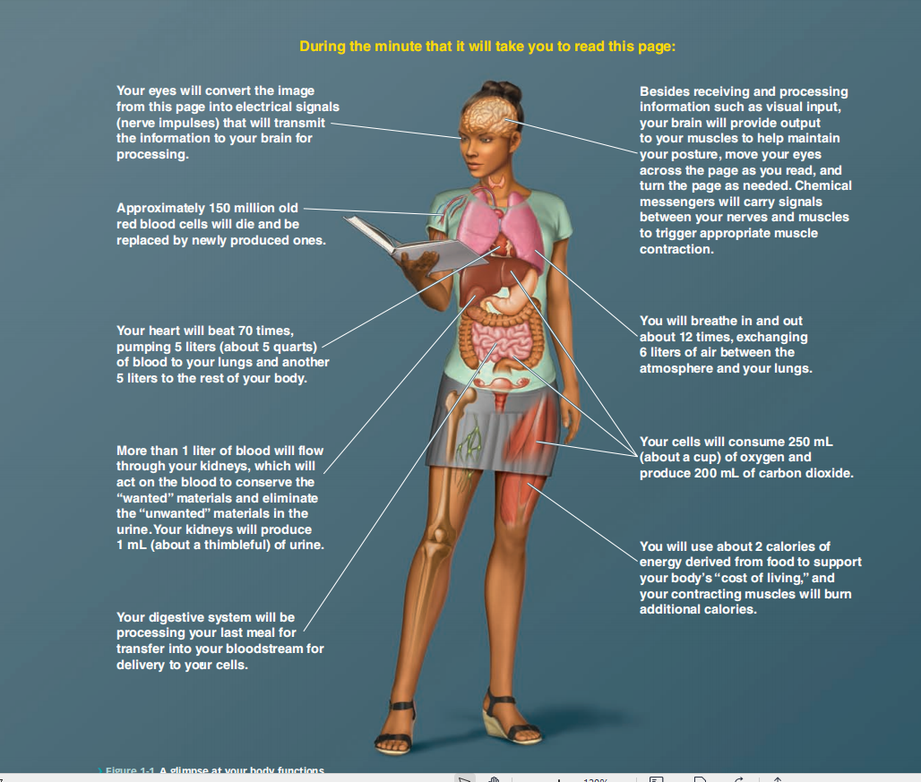

Slide 4
Physiology
Normal functions of living
organism
Anatomy
Biochemistry
Normal Structure of living
organism
Chemicals in living organism

Slide 5
Physiology
“A branch of biology dealing with the functions and activities of living organisms and their parts”
“Physiology is the study of the normal function of cell, tissue, organs, systems and organisms, including all physical and chemical processes.”
Physiology (from Ancient Greek: physio = nature; logos = study): study of how the body works to maintain life
cell 🡪 tissue 🡪 organ 🡪 organ system 🡪 organism
Human physiology is the scientific study of normal body function.
Notes:
A sub-discipline of biology, its focus is in how organisms, organ systems, organs, cells, and bio-molecules carry out the chemical or physical functions that exist in a living system.
Human physiology seeks to understand the mechanisms that work to keep the human body alive and functioning, through scientific enquiry into the nature of mechanical, physical, and biochemical functions of humans, their organs, and the cells of which they are composed

Slide 6
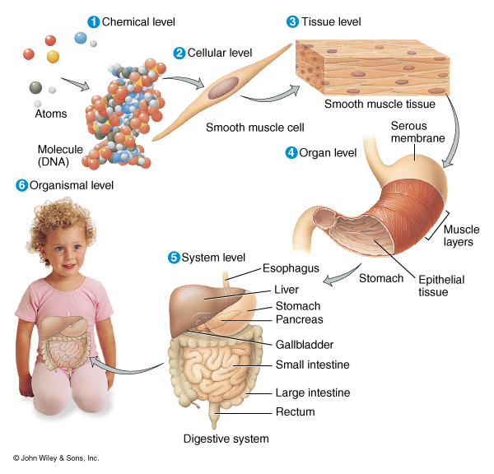
Levels of Organization
Chemical
Cellular
Tissue
Organs
System Level

Slide 7
Levels of Organization
At the chemical level, atoms, molecules, and the chemical bonds between atoms provide the framework upon which all living activity is based.
The cell is the smallest unit of life. The entire body contains about 100 trillion cells.
  A tissue is a group of similar cells performing a common function. 4 basic tissue types: epithelium, muscle,
  connective tissue, and nerve
Notes:
Organelles within the cell are specialized bodies performing specific cellular functions. Cells themselves may be specialized. Thus, there are nerve cells, bone cells, and muscle cells

Slide 8
An organ is a group of different kinds of tissues working together to perform a particular activity. The heart is an organ composed of muscle, nervous, connective, and epithelial tissues.
An organ system/body system is two or more organs working together to accomplish a particular task.
For example digestive system, involves the coordinated activities of many organs, including the mouth, stomach, small and large intestines, pancreas, and liver.(Do not act in isolation from one another)
Organismic level - one living individual
Notes:
->sometimes an organ is part of more than one system
Organismic level - one living individual
—the ability to obtain and process energy, the ability to respond to environmental changes, and the ability to reproduce.

Slide 9
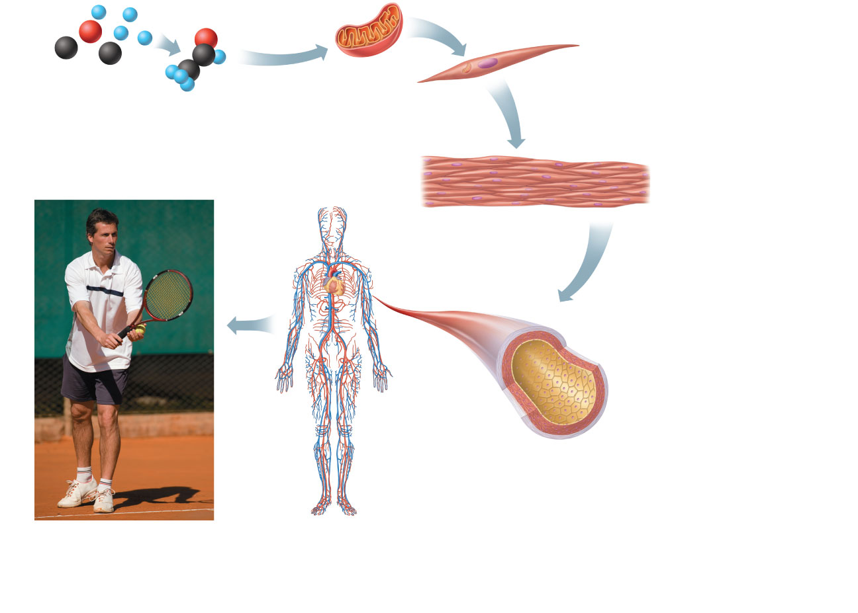
Organism Level
Atoms
Molecule
Organelle
Smooth muscle cell
Cellular level
Cells are made up
of molecules.
1
2
Chemical level
Atoms combine to
form molecules.
Smooth muscle tissue
Cardiovascular
system
Tissue level
Tissues consist of
similar types of cells
3
Heart
Blood
vessels
Blood vessel
(organ)
Smooth muscle tissue
Connective tissue
Epithelial
tissue
Organ level
Organs are made up of
different types of tissues.
4
Organ system level
Organ systems consist of
different organs that work
together closely.
Organismal level
The human organism
is made up of many
organ systems.
5
6

Slide 10
All Our body system are working together to carry out all needed life functions in a coordinated way.
Growth Repair of injuries
Get energy Get building materials
Get rid of waste
Keep away disease
Respond to changing environment
Reproduce
Human body has 11 systems

Slide 11
Eleven Body Systems work together to maintain homeostasis and carry out these tasks:
1. Nervous System 2. Endocrine System
3. Lymphatic System 4. Circulatory System
5. Respiratory System 6. Digestive System
7. Excretory System 8. Skeletal System
9. Muscular System 10. Integumentary System
11. Reproductive System

Slide 12
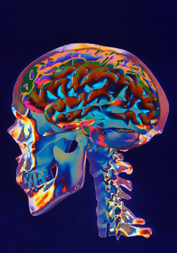
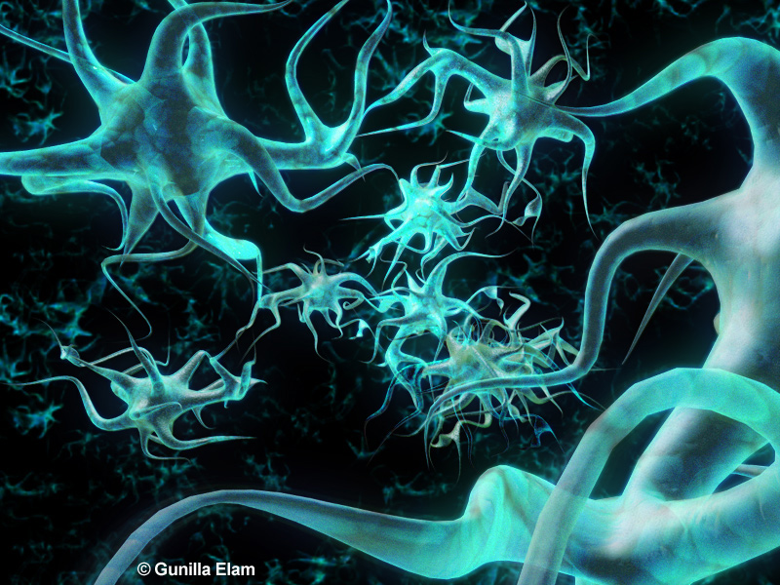
1. Nervous System:
Structures: Brain, Spinal Cord, Peripheral Nerves, Neurons (Cells of nervous system)
Functions: Coordinates the body’s response to changes to internal and external environment

Slide 13
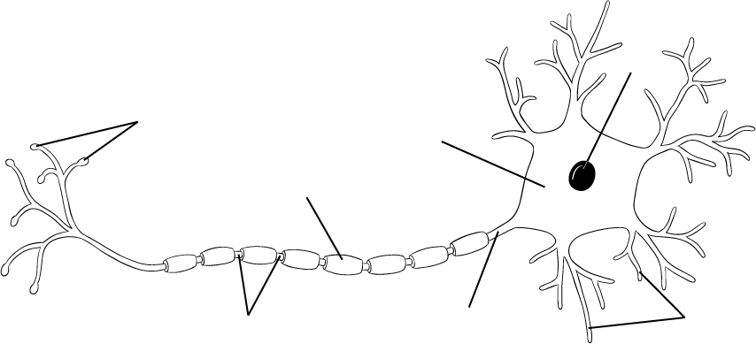
The Nervous System:
The nervous system is the number one communication center of the body. The basic cell type that carries the communications is a network of neurons that transmit electrical impulses.
NEURON CELL
Nucleus
Axon terminals
Cell Body
Myelin Sheath
Nodes
Dendrites

Slide 14
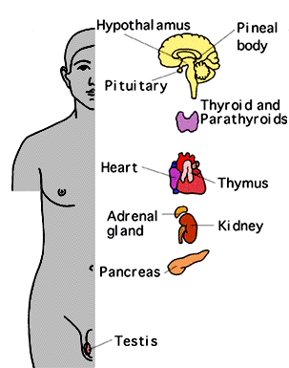
2. Endocrine System – Hormone System
Structures: Glands - Hypothalmus, pituitary, thyroid, parathyroids, adrenals, pancreas, ovaries (in females), testes (in males)
Functions: Produce Hormones. Controls growth, development, metabolism, and reproduction

Slide 15
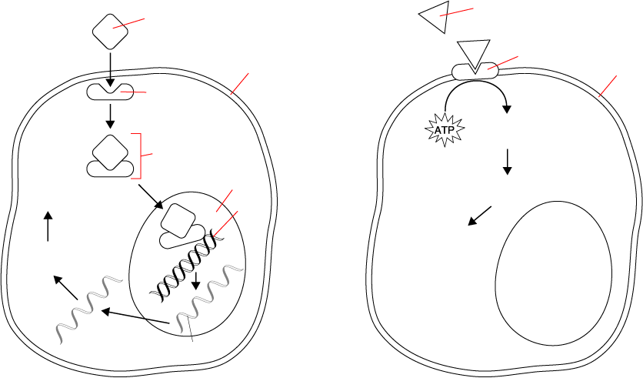
The Endocrine System Sends messages throughout the body by way of chemicals known as hormones. Hormones travel throughout the blood stream to target cells which contain matching receptors.
Hormone
Receptor

Slide 16
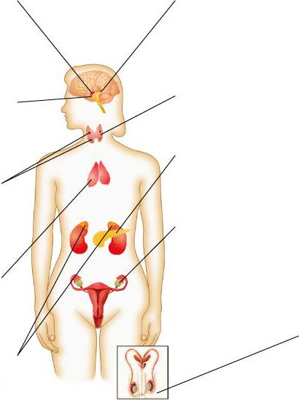
Hypothalamus
Pineal Gland
Pituitary
Thyroid
Pancreas
Parathyroids
Thymus
Ovary (female)
Adrenal Glands
Testis (male)

Slide 17
Important Glands and Hormones of the Human Body
Gland | Hormone | Function
Pineal | Melatonin | Controls sleep and wake cycle
Thyroid | Thyroxine | Controls appetite and metabolism
Adrenal | Adrenaline | Deals with stressful situations
Thymus | Thymosin | T-cell development (fight diseases)
Ovary | Estrogen | Female reproduction
Testis | Testosterone | Male reproduction

Slide 18
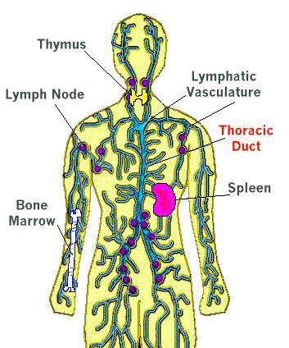
3. Lymphatic System – Immune System
Structures: White blood cells, thymus, spleen, lymph nodes, lymph vessels
Function: Collects fluid that lost from blood vessels, leaks into body tissues and returns it to the circulatory system

Slide 19
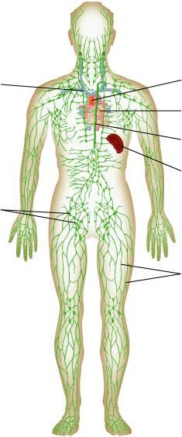
Helps to protect the body from disease;
Lymph nodes filters that collected invaders that cause disease.
Superior Vena
Cava
Thymus
Heart
Thoracic
Duct
Lymph Nodes
Spleen
Lymph Vessels

Slide 20
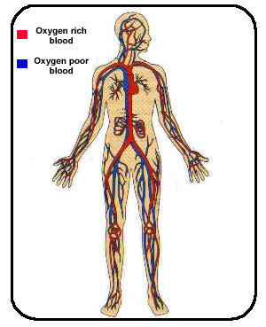
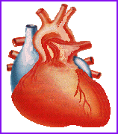
4. Circulatory System
Structures: Heart, Blood vessels, blood
Functions: Brings oxygen, nutrients, and hormones to cells; fights infection; regulates body temperature.
Notes:
The circulatory system works together with several other body systems to bring needed supplies to cells which cannot move. The circulatory system is a delivery system

Slide 21
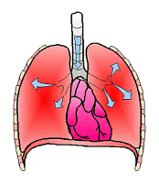
5. Respiratory System
Structures: Nose, pharynx, larynx, trachea, bronchi, bronchioles, lungs
Functions: Provides oxygen needed for cellular respiration and removes carbon dioxide from body.

Slide 22
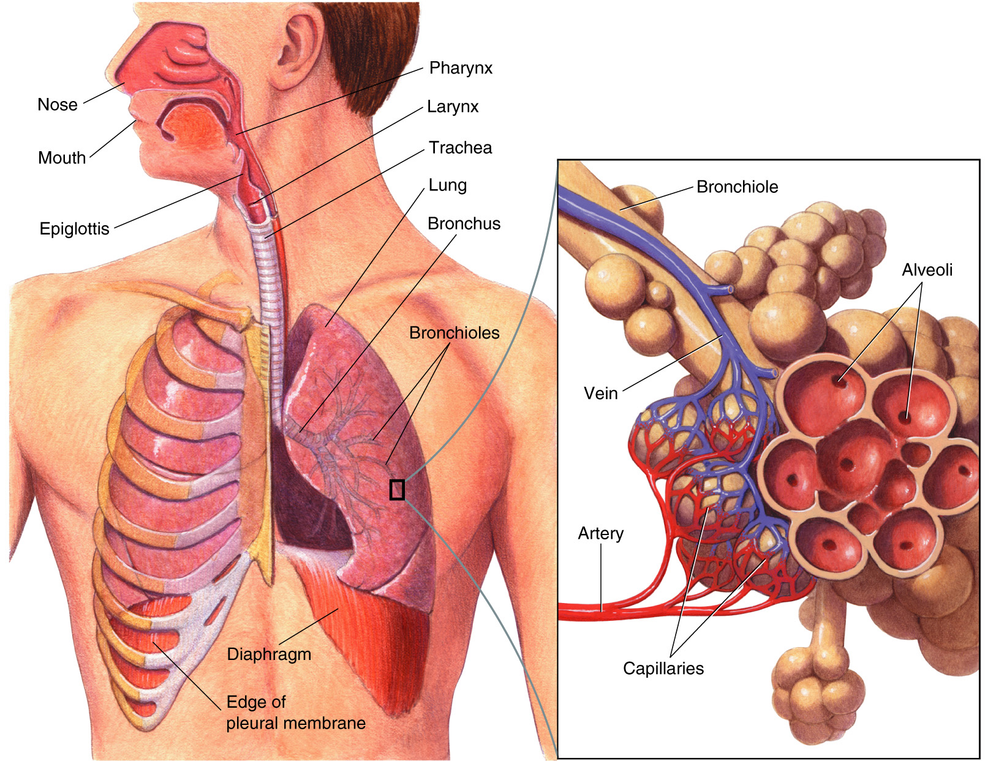
Figure 37-13 The Respiratory System
Bronchi branch to air sacs known as aveoli where gas exchange occurs
Section 37-3
Notes:
The Lungs are only air sacs. In order for them to move they must work together with a muscle known as the Diaphragm

Slide 23
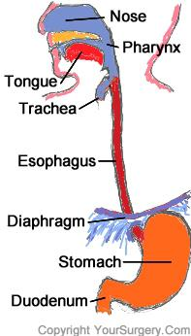
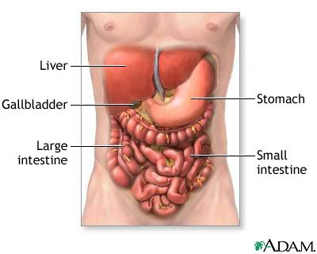
6. Digestive System
Structures: Mouth, pharynx, larynx, esophagus, stomach, liver, pancreas, small and large intestines,
Function: Breaks down foods into simple molecules that can be used by the body for respiration and building cells

Slide 24
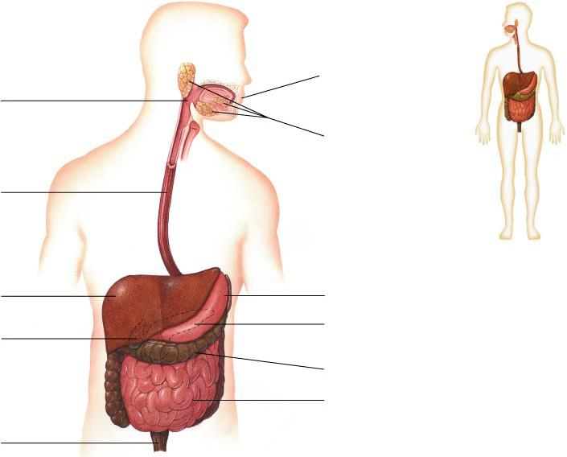
The Digestive System
Mouth
Pharynx
Salivary Glands
Esophagus
Liver
Stomach
Pancreas behind stomach
Gallbladder
Large Intestine
Small Intestine
Rectum

Slide 25
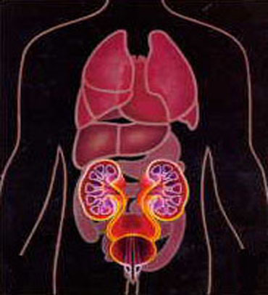
7. Excretory System
Structures: Skin, lungs, kidneys (nephrons), ureters, urinary bladder, urethra
Functions: Removes waste products of metabolism from the body

Slide 26
Excretory System:
In the process of obtaining nutrients and carrying out chemical reactions the human body produces wastes (CO₂, Urea, Salts). If some of these wastes are not removed they could threaten our health. Excess chemicals that are not toxic also need to be removed.

Slide 27

Other important parts of the bodies excretory system
  The skin excretes excess water and salts
  The lungs excrete carbon dioxide produced from respiration
Both of these body organs serves multiple functions
in the human body.

Slide 28
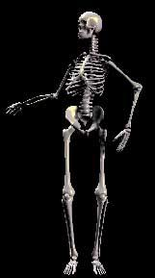
8. Skeletal System
Structures: Bones, cartilage, ligaments, tendons
Functions: Supports the body; protects internal organs; allows movement; stores mineral reserves; provides a site for blood formation

Slide 29
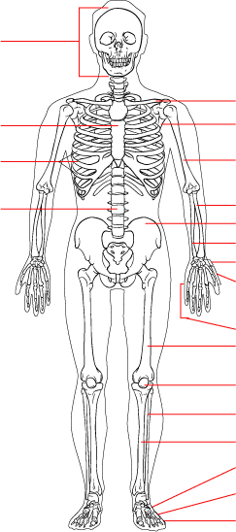
A. Skeletal System
Skull
Clavicle
There are 206 bones in the adult human body. These bones provide a system of supports and levers on which muscles can produce movement
Sternum
Scapula
Ribs
Humerus
Vertebral column
Radius
Pelvis
Ulna
Carpals
Metacarpals
Phalanges
Femur
Patella
Fibula
Tibia
Tarsals
Metatarsals
Phalanges

Slide 30
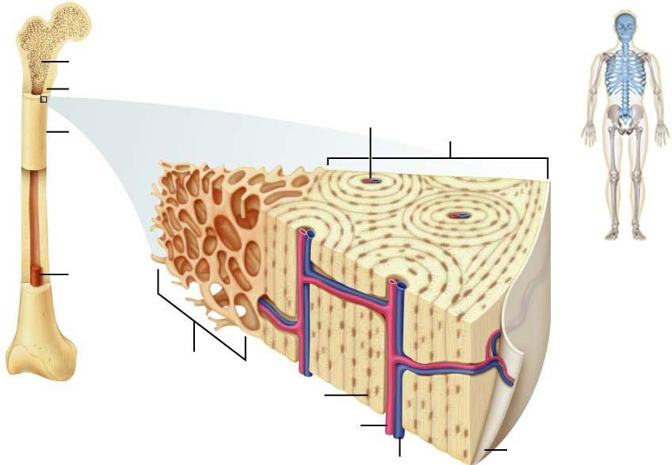
Bones are a solid network of living cells and protein fibers that are surrounded by calcium deposits.
Bone Marrow
Notes:
Bones contain blood vessels and cavities containing marrow. Red marrow produces red blood cells, white blood cells and platelets

Slide 31
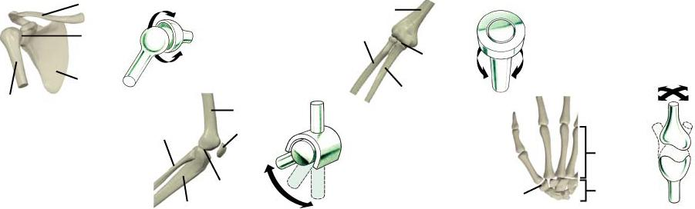
Joints are places where one bone attaches to another.
Ball-and-Socket Joint
Pivot Joint
Clavicle
Elbow
Hinge Joint
Saddle Joint
Knee
Freely Movable Joints and Their Movements
Notes:
Each type of joint is designed to allow movement without damaging the other bones. Joints in the skull allow no movement, joints in the spine allow a small amount of movement and those shown below allow movement in one or more directions.

Slide 32
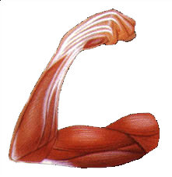
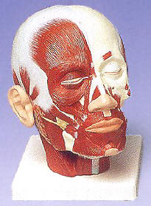
9. Muscular System
Structures: Skeletal muscle, smooth muscle, cardiac muscle
Function: Works with skeletal system to produce voluntary movement; helps circulate blood and move food through the digestive system

Slide 33
The Muscular System
More than 40% of the average human is muscle. Muscles are involved in both voluntary actions and involuntary actions. Three types of muscles cells are:
Skeletal – Attached to bones for voluntary actions
Smooth – Found in body`s visceral organs e.g digestive tract and the blood vessels to move food and blood. Control involuntary actions (you do not decide for them to work)
Cardiac – Heart muscle cells are involuntary.

Slide 34
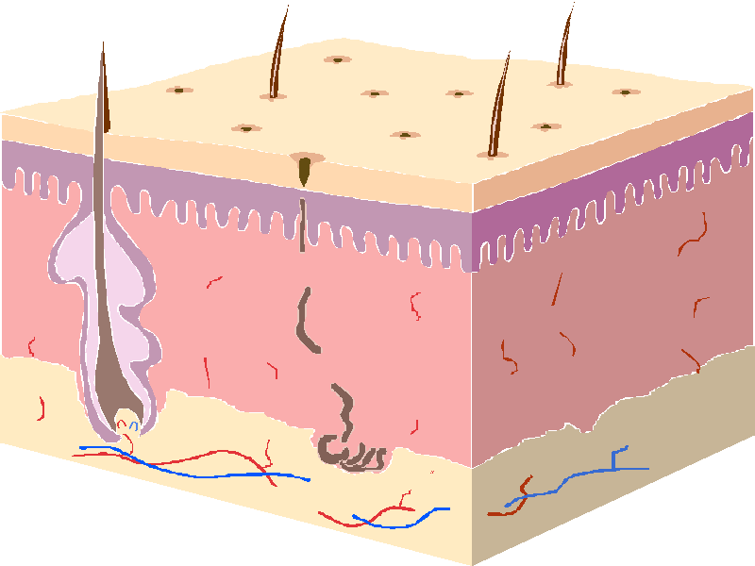

10. Integumentary System (Skin)
Structures: Skin, Hair, Nails, Sweat and Oil Glands
Functions:
Serves as a barrier against infection and injury
Helps regulate body temperature
removes excess salts and water
Protects internal cells from UV radiation
Serves as one link between the nervous system and the environment (receives information on pressure, temperature, pain)

Slide 35


Hair and Nails are made up of a substance known as keratin. They are both used to protect the skin from damage:
Fingernails and toe nails protect the tips of your toes and fingers
Hair on your head protects from UV rays
Eyelashes, Nose Hair and Ear Hair prevent dirt and other particles from entering the body.

Slide 36
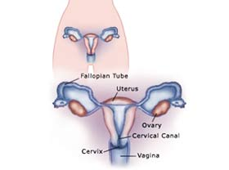
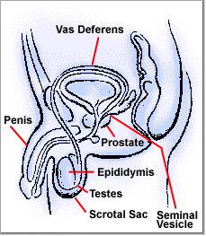
11. Reproductive System
Structures:
Female- Uterus, Fallopian tubes, ovary, cervical canal, cervix, vagina
Male – Penis, Vas Deferens, Prostate, Epididymis, Testes, Scrotal Sac, Seminal Vesicle
Function: Produces reproductive cells; in females nurtures and protects developing embryo

Slide 37
All Our body system are working together to carry out all needed life functions in a coordinated way.
Human Body Regulate all these body systems and make them work together with the help of
Nervous System & Endocrine System
The Respiratory System links to the Circulatory
System to provide cells with oxygen and remove
carbon dioxide.

Slide 38



We move from place to place and have the ability to run, blink or build things . . . . . These things are all made possible by the skeletal and muscular systems.
The Digestive and Excretory Systems together are responsible for bringing in food and getting rid of the leftovers.

Slide 39
Scope and Relevance of Physiology to Dentistry
Physiology is the branch of science that deals with the normal functions of the human body.
In dentistry, physiology provides the fundamental understanding required to diagnose, treat, and prevent oral and systemic diseases.
In dentistry, understanding physiology is essential because dental practice deals directly with living tissues and their functions.

Slide 40
Scope of Physiology in Dentistry
Oral and Dental Physiology
  Structure and function of teeth, periodontium, oral mucosa, tongue, and salivary glands
  Saliva formation, composition, and functions
  Mastication, deglutition (swallowing), and speech
2. Neurophysiology
  Sensation of pain, touch, pressure, and temperature in oral tissues
  Trigeminal nerve function
  Mechanism of local anesthesia
3. Muscle Physiology
  Muscles of mastication and facial expression
  Jaw movements and occlusion

Slide 41
4. Muscle Physiology
  Muscles of mastication and facial expression
  Jaw movements and occlusion
5. Cardiovascular Physiology
  Blood supply to oral tissues
  Management of patients with hypertension, heart disease, and shock.
  6. Endocrine Physiology
  Hormonal influences on growth, tooth eruption, bone metabolism, and periodontal health.
  7. Hematological and Immune Physiology
  blood clotting, healing, and defense mechanisms
  Management of bleeding disorders and infections

Slide 42
Relevance of Physiology to Dentistry
Basis for Clinical Practice
Helps understand normal oral functions and identify abnormalities
Pain Control and Anesthesia
Essential for safe and effective use of local and general anesthesia
Diagnosis and Treatment Planning
Understanding systemic conditions affecting oral health
Dental Materials and Procedures
Tissue response to restorative materials, implants, and prostheses
Management of Medically Compromised Patients
Safe dental care for patients with systemic diseases
Prevention and Health Promotion
Understanding saliva, diet, and oral defense mechanisms

Slide 43
Conclusion
Physiology provides the scientific foundation for dentistry. A thorough knowledge of physiological principles enables dentists to diagnose accurately, treat safely, manage systemic conditions, and promote oral and general health effectively.

